Slide 1
Synchronization

Slide 2
Synchronization and Coordination
Distributed Algorithms
Time and Clocks
Global State
Concurrency Control
Distributed Transactions

Slide 3
Synchronization
How processes cooperate and synchronize with each other?
Simultaneously access a shared resources , such as printer,
Agree on the ordering of events, such as whether message m1 from process P was sent before or after message m2 from process Q.

Slide 4
DISTRIBUTED ALGORITHMS
Algorithms that are intended to work in a distributed environment.
Used to achieve tasks such as:
Communication
Accessing resources
Allocating resources
etc.
Synchronization and coordination linked to distributed algorithms
Achieved using distributed algorithms

Slide 5
SYNCHRONOUS Vs ASYNCHRONOUS DISTRIBUTED SYSTEMS
Timing model of a distributed system
Affected by:
Execution speed/time of processes
Communication delay
Clocks & clock drift
(Partial) failure

Slide 6
Synchronous Distributed System:
Time variance is bounded
Execution: bounded execution speed and time
Communication: bounded transmission delay
Clocks: bounded clock drift (and differences in clocks)
Effect:
Easier to design distributed algorithms
Very restrictive requirements
Limits concurrent use of network
Require precise clocks and synchronization

Slide 7
Asynchronous Distributed System
Time variance is not bounded
Execution: different steps can have varying duration
Communication: transmission delays vary widely
Clocks: arbitrary clock drift
Effect:
Allows no assumption about time intervals
Most asynch DS problems hard to solve
Solution for asynch DS is also a solution for synch DS
Most real distributed systems are hybrid synch and asynch.

Slide 8
EVALUATING DISTRIBUTEDA LGORITHMS
General Properties:
Performance
number of messages exchanged
response/wait time
delay
throughput
complexity:
Efficiency
resource usage: memory, CPU, etc.
Scalability
Reliability
number of points of failure (low is good)

Slide 9
SYNCHRONIZATION AND COORDINATION
making sure that processes doing the right thing at the right time.
allowing processes to synchronize and coordinate their actions
Two fundamental issues:
Coordination (the right thing)
Synchronization (the right time)

Slide 10
COORDINATION
Coordination refers to coordinating the actions of separate processes relative to each other and allowing them to agree on global state.
“Coordinate actions and agree on values.”
Coordinate Actions:
What actions will occur
Who will perform actions
Agree on Values:
Agree on global value
Agree on environment
Agree on state

Slide 11
Cont …
Examples of coordination include ensuring that processes agree on –
  what actions will be performed?
  who will be performing actions?
  and the state of the system?

Slide 12
SYNCHRONIZATION
Synchronization is coordination with respect to time, and refers to the ordering of events and execution of instructions in time.
“Ordering of all actions”
Total ordering of events
(whether message m1 from process P was sent before or after message m2 from process Q)
Ordering of access to resources

Slide 13
Cont …
Examples of synchronization include,
Ordering distributed events and ensuring that a process performs an action at a particular time.

Slide 14
MAIN ISSUES
Time and Clocks: synchronizing clocks and using time in distributed algorithms
Global State: how to acquire knowledge of the system’s global state
Concurrency Control: coordinating concurrent access to resources
Coordination: when do processes need to coordinate and how do they do it

Slide 15
TIME AND CLOCKS

Slide 16
TIME AND CLOCKS
It is often important to know when events occurred and in what order they occurred.
In a non-distributed system dealing with time is trivial as there is a single shared clock, where all processes see the same time.

Slide 17
Cont …
In a distributed system, on the other hand, each computer has its own clock.
Because no clock is perfect each of these clocks has its own skew which causes clocks on different computers to drift and eventually become out of sync.

Slide 18
CLOCKS
Computer Clocks:
Oscillates at known frequency
Clock Skew:
Different computers run at slightly different rates
Clocks get out of sync
Maximum drift rate
Timestamps:
Used to denote at which time an event occurred

Slide 19
PHYSICAL CLOCKS
Based on actual time:
Physical clocks keep track of physical time.
In distributed systems that based on actual time it is necessary to keep individual computer clocks synchronized.
The clocks can be synchronized to global time (external synchronization), or to each other (internal synchronization).

Slide 20
PHYSICAL CLOCKS
Examples:
Performing events at an exact time (turn lights on/off, lock/unlock gates)
sorting of events (for security, for proﬁling)
Tracking (tracking a moving object with separate cameras)

Slide 21
SYNCHRONIZING PHYSICAL CLOCKS
External Synchronization:
Clocks synchronize to an external time source
Synchronize with UTC every δ seconds
Internal Synchronization:
Clocks synchronize locally
Only synchronized with each other
Time Server:
Server that has the correct time
Server that calculates the correct time

Slide 22
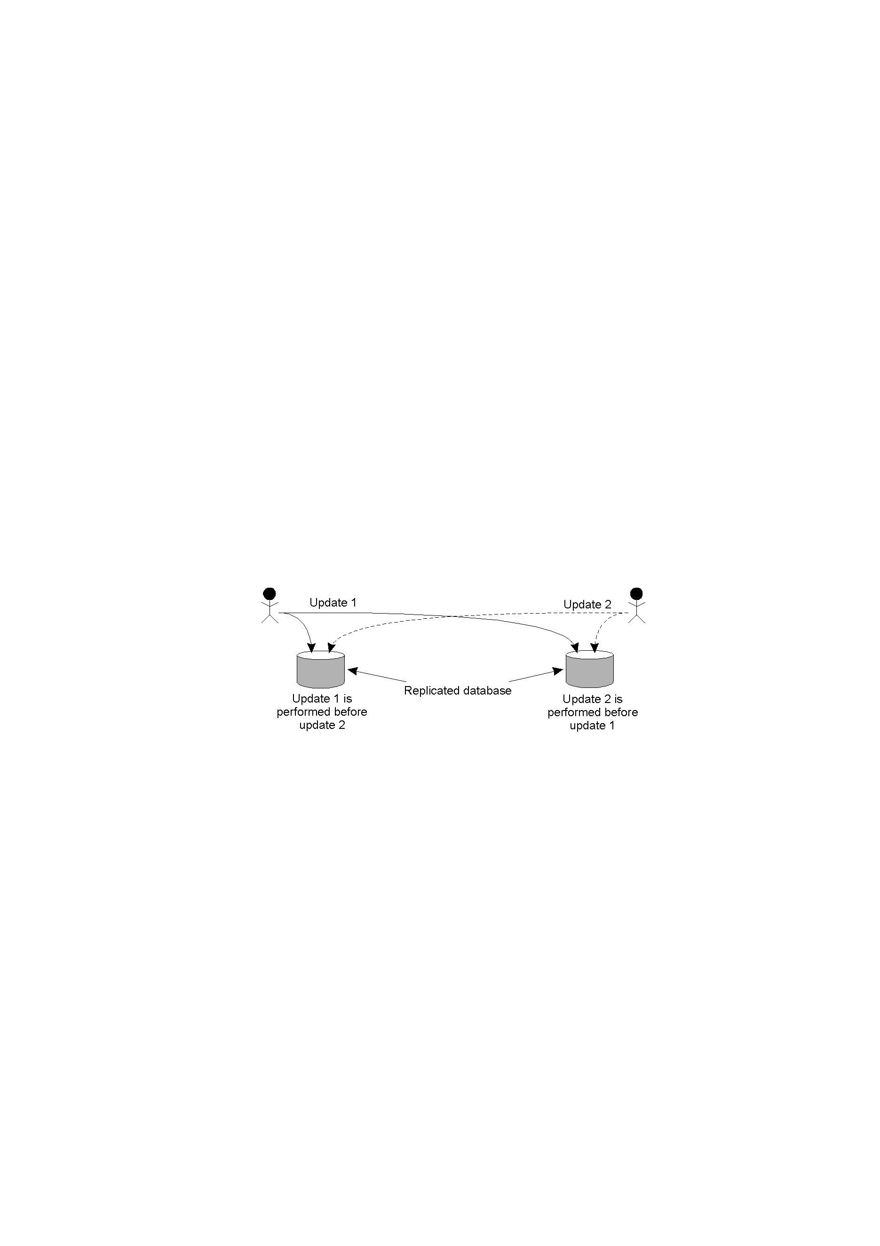
What can go wrong?
We need to guarantee that concurrent updates on a replicated database are seen in same order everywhere. This requires a totally-ordered multicast.
Update 1: adds 100 rupees to an account, (initial value= 1000/-)
Update 2: adds 1% interest to the same account.
In absence of proper synchronization: replica 1=1111, replica 2= 1110
Clock reading might be different for different computers!
Inconsistent state
Can use Lamport’s to totally order

Slide 23
Computer Clock
We need to measure time accurately:
  to know the time an event occurred at a computer
Algorithms for clock synchronization useful for
  concurrency control based on timestamp ordering
  uthenticity of requests e.g. in Kerberos etc
Each computer in a DS has its own internal clock

Slide 24
Clock Synchronization
There exists a time server receiving signals from a UTC source
  Cristian’s algorithm
There is no UTC source available
  Berkley’s algorithm
Exact time does not matter!
  Lamport’s algorithm

Slide 25
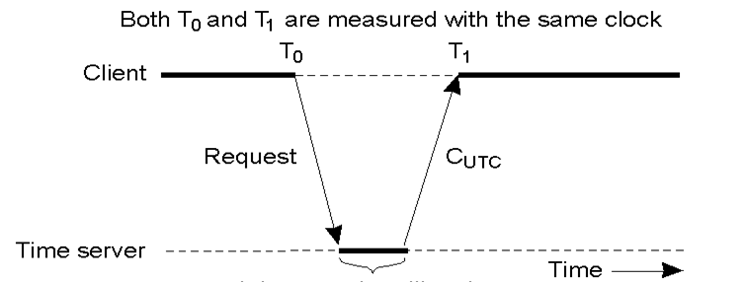
Clock Sync. Algorithm: Cristian's
Cristian’s algorithm requires clients to periodically synchronize with a central time server (typically a server with a UTC receiver)
Every computer periodically asks the “time server” for the current time
The server responds ASAP with the current time C_{UTC}
The client sets its clock to C_{UTC}

Slide 26
Berkeley Algorithm
An algorithm for internal synchronization of a group of computers
A master polls to collect clock values from the others (slaves)
The master uses round trip times to estimate the slaves’ clock values
It takes an average
It sends the required adjustment to the slaves
If master fails, can elect a new master to take over

Slide 27
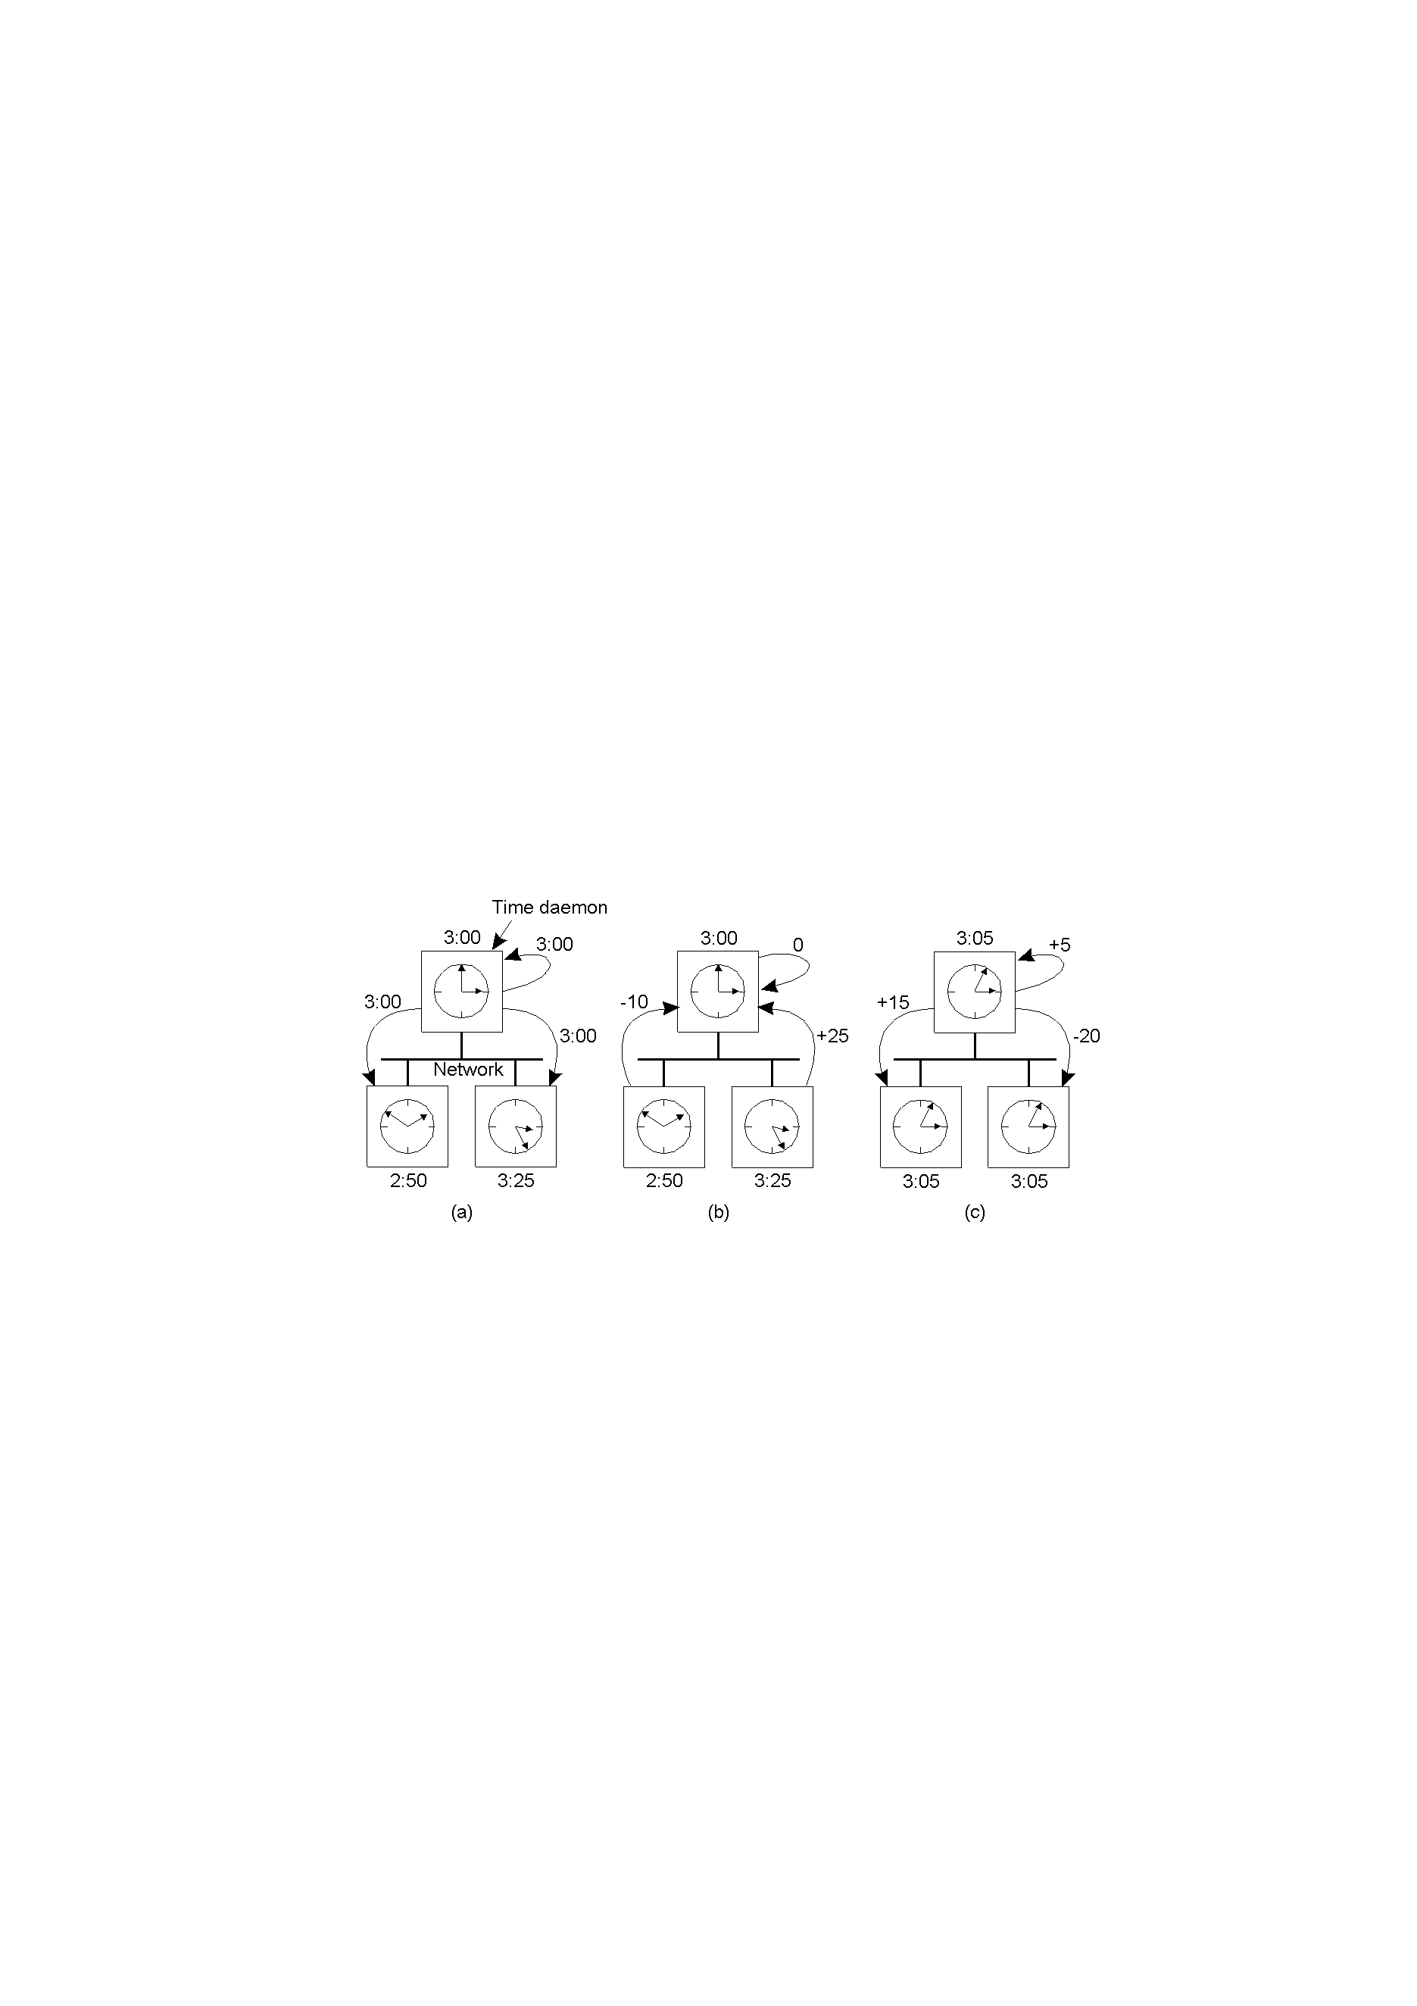
The Berkeley Algorithm
The time daemon asks all the other machines for their clock values
The machines answer
Takes an average & tells everyone how to adjust their clock

Slide 28
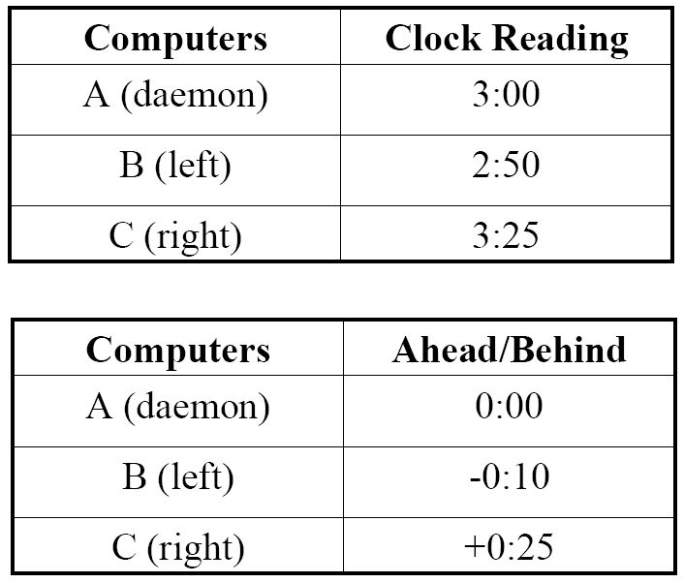
Berkeley Algorithm

Slide 29
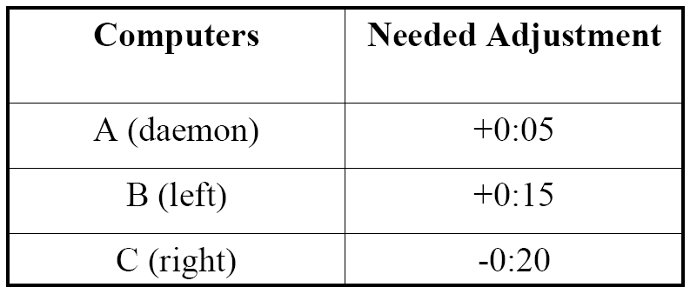
Berkeley Algorithm
Average time: 3:05

Slide 30
LOGICAL CLOCKS
The relative ordering of Events is more important than actual physical time in many applications
In a single process the ordering of events (e.g., state changes) is trivial
In a distributed system, however, besides local ordering of events, all processes must also agree on ordering of causally related events (e.g., sending and receiving of a single message)
Local ordering:
System consists of N processes pi
If pi observes e before e′ , we have e →e′
Global ordering:
Lamport’s happened before relation →
Smallest relation, such that
1. e →e ′
2. For every message m , send (m ) → receive (m )
3. Transitivity: e→ e′ and e′ →e ′′ implies e →e′′

Slide 31
ORDERING EVENTS
Event ordering linked with concept of causality:
  Saying that event a happened before event b is same as saying that event a casually affects event b
  If events a and b happen on processes that do not exchange any data, their exact ordering is not important

Slide 32
Relation “has happened before”
Smallest relation satisfying the three conditions:
  If a and b are events in the same process and a comes before b, then a → b
  If a is the sending of a message by a process and b its receipt by another process then
  a → b
  If a → b and b → c then a → c.

Slide 33
Relation “has happened before”
We cannot always order events: relation “has happened” before is only a preorder
If a did not happen before b, it cannot causally affect b.

Slide 34
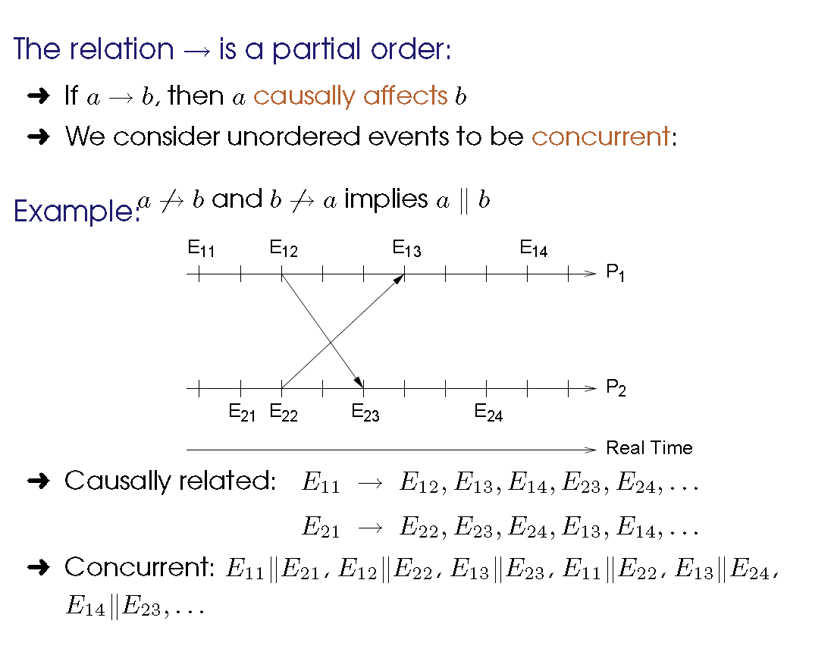
LOGICAL CLOCKS

Slide 35
Lamport Algorithm
Each process increments local clock between any two successive events
Message contains a timestamp
Upon receiving a message, if received timestamp is ahead, receiver fast forward its clock to be one more than sending time

Slide 36
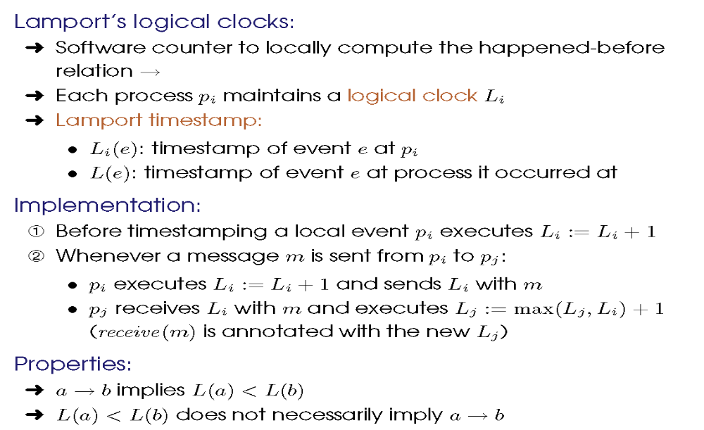
Lamport Algorithm

Slide 37
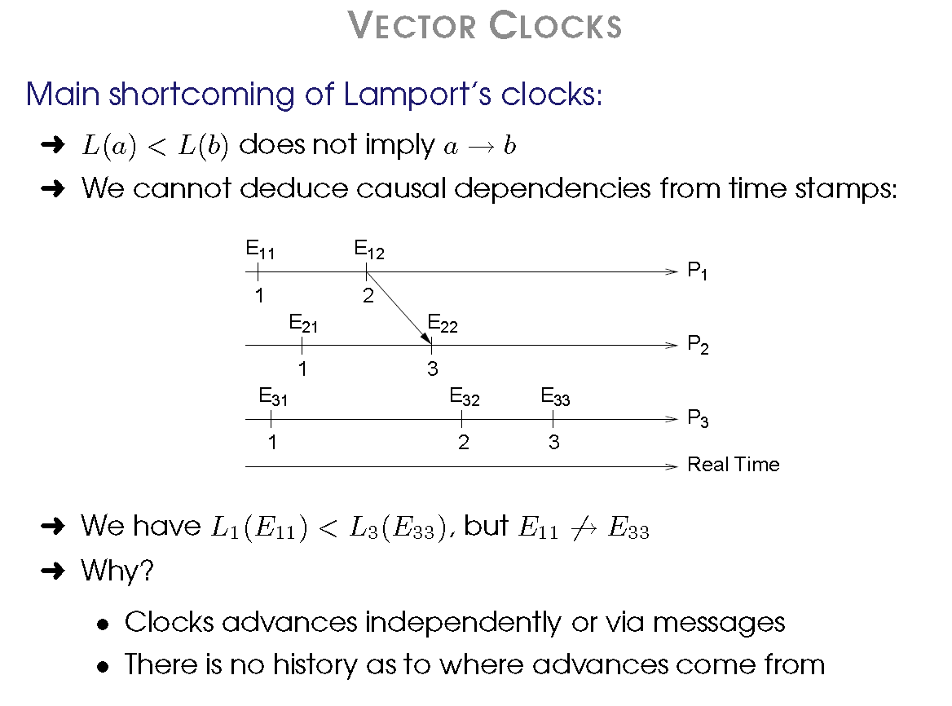
VECTOR CLOCKS

Slide 38
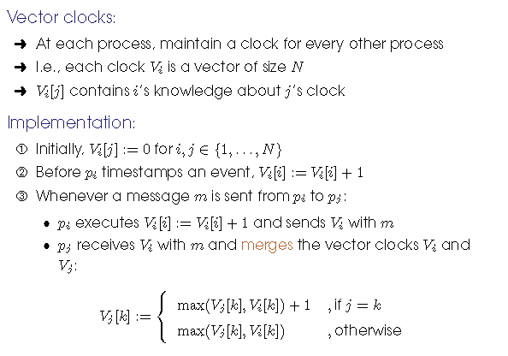
VECTOR CLOCKS

Slide 39
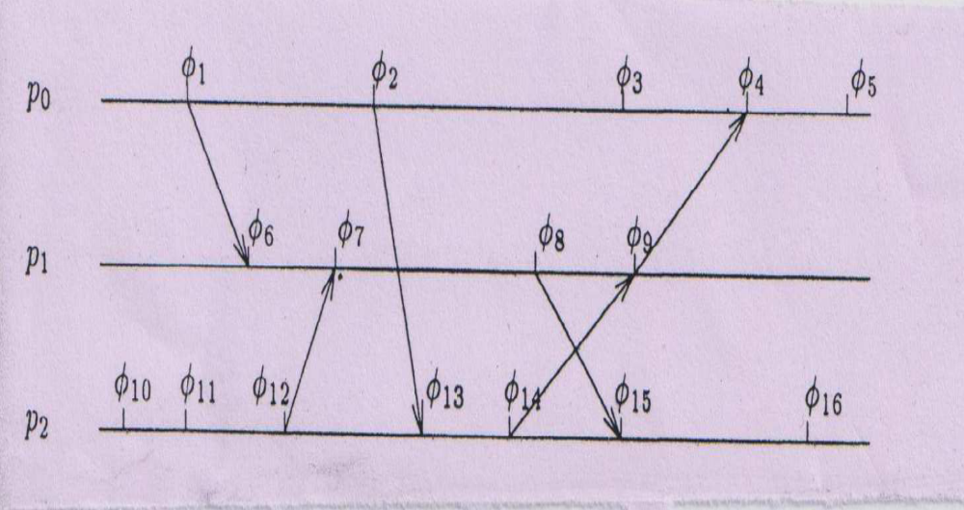
Tutorial- Lamport and Vector Clock
For the figure below, write down the lamport clock and vector clock value at each event.

Slide 40
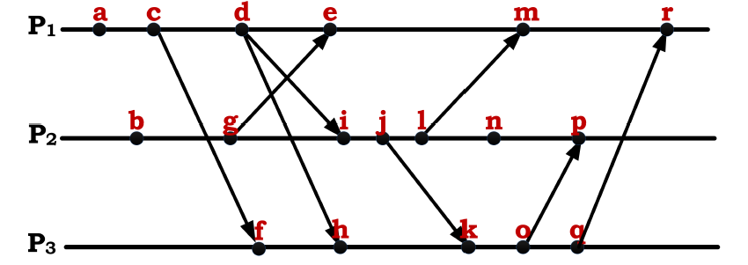
Tutorial- Lamport and Vector Clock
For the figure below, write down the lamport clock and vector clock value at each event.

Slide 41
GLOBAL STATE

Slide 42
Determining Global States
Global State
“The global state of a distributed computation is the set of local states of all individual processes involved in the computation plus the state of the communication channels.”

Slide 43
Determining Global States
Knowing the global state of distributed system may be useful for many reasons.
For example:
How to know that system is dealing with deadlock or distributed computation has correctly terminated?

Slide 44
GLOBAL STATE
Determining global properties: often difficult, but essential for some applications.
Distributed garbage collection:
  Do any references exist to a given object?: Collects remote server objects that are no longer referenced by any client in the network
.
Distributed deadlock detection:
Do processes wait in a cycle for each other?
Distributed algorithm termination detection:
Did a set of processes finish all activity? (Consider messages in transit)
All these properties are stable: once they occur, they do not disappear without outside intervention.

Slide 45
Analysis of GLOBAL STATE (Distributed Snapshot)
A distributed snapshot reflects a state in which the distributed system might have been.
A snapshot reflects a consistent global state
Example: if we have recorded that a process Q has received a message from another process P,
then we should also recorded that process P has actually sent that message
Otherwise, a snapshot will contain the recording of messages that have been received but never sent,
Which indicate the inconsistent global state
The reverse condition (P has sent a message that Q has not yet received) is allowed

Slide 46
More on States
process state
  memory state + register state + open files + kernel buffers + …
        Or
  application specific info like transactions completed, functions executed etc,.
channel state
  “Messages in transit” i.e. those messages that have been sent but not yet received

Slide 47
Why global state determination is difficult in Distributed Systems?
Distributed State :
Have to collect information that is spread across several machines!!
Only Local knowledge :
A process in the computation does not know the state of other processes.

Slide 48
Difficulties due to Non Determinism
Deterministic Computation
  At any point in computation there is at most one event that can happen next.
Non-Deterministic Computation
  At any point in computation there can be more than one event that can happen next.

Slide 49
Deterministic Computation Example
A Variant of producer-consumer example
Producer code:
while (1)
{
produce m;
send m;
wait for ack;
}
Consumer code:
while (1)
{
recv m;
consume m;
send ack;
}

Slide 50
Example: Initial State
m

Slide 51
Example
m

Slide 52
Example
m

Slide 53
Example
a

Slide 54
Example
a

Slide 55
Example
a

Slide 56
Deterministic state diagram

Slide 57
Non-deterministic computation
3 processes
p
m₁
q
m₂
r
m₃

Slide 58
Election Algorithms
In distributed computing, leader election is the process of designating a single process as the organizer of some task distributed among several computers (nodes).
Before the task is begun, all network nodes are unaware which node will serve as the "leader," or coordinator, of the task.
After a leader election algorithm has been run, however, each node throughout the network recognizes a particular, unique node as the task leader.

Slide 59
Election Algorithms
Many distributed algorithms require one process to act as coordinator, initiator, or otherwise perform special role.
All processes in distributed systems may be equal characteristics, there is no way to select one of them to be special.
  Assume have some “ID” that is a number, that every process knows the process number of every other process.
“elect” process with the highest number as leader

Slide 60
Election Algorithms
Election
  Goal: ensure that the election achieves an agreement among all the processes
  the P with the highest id is elected

Slide 61
The Bully Algorithm
When a process notices that the coordinator in no longer responding to requests, it initiates an election.
A process ,P, holds an election as follows
P sends an ELECTION message to all process with higher numbers.
If no one responds, P wins the election and becomes coordinator.
If one of the higher-ups answers, it takes over. P’s job is done
Finally only a P (the new coordinator) will remain and it will inform the other by sending a msg
If a process is restarted, the first action is to trigger an election

Slide 62
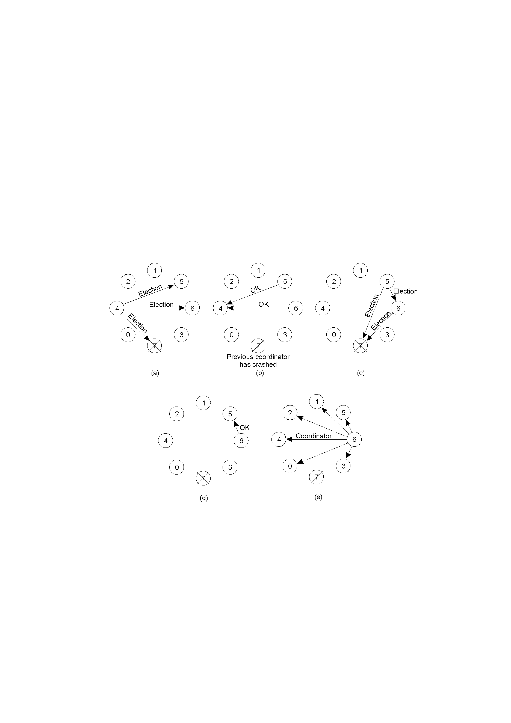
The Bully Algorithm (1)
Process 4 notices 7 down
Process 4 holds an election
Process 5 and 6 respond, telling 4 to stop
Now 5 and 6 each hold an election

Slide 63
The Bully Algorithm (2)
Process 6 tells process 5 to stop
Process 6 wins and tells everyone
Eventually “biggest” (bully) wins
If processes 7 comes up, starts elections again

Slide 64
A Ring Algorithm
processes are ordered in such way that each process knows who its successor is.
When a P suspects a coordinator fault
  Sends an ELECTION msg containing its Pid to the next (successor); if it is down, the sender skips over the successor & the msg is sent to the next of the ring
  Each member of the network receives and propagates a msg to the next, adding its id

Slide 65
A Ring Algorithm
When a msg return to a P who sent it (verify by inspecting the list), the msg is turned into COORDINATOR and circulated, to report:
  New coordinator: P of the list with highest id
  Multiple messages can circulate over the network

Slide 66
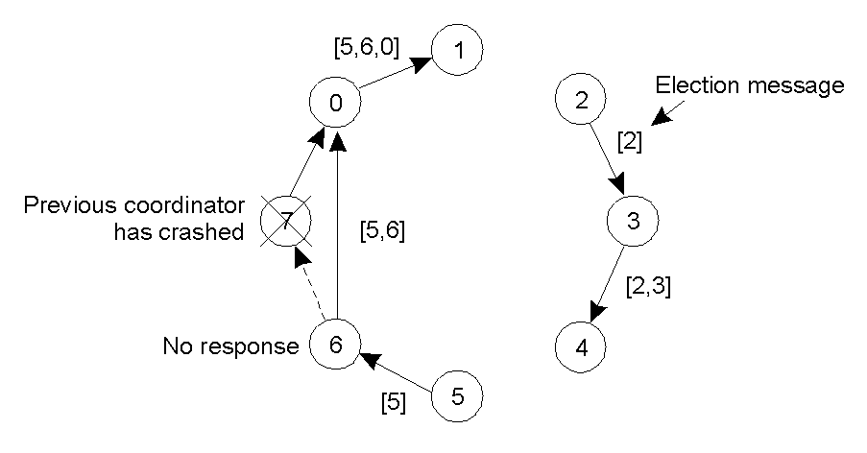
A Ring Algorithm
  Once around, change to COORDINATOR (biggest)
Even if two ELECTIONS started at once, everyone will pick same leader

Slide 67
CONCURRENCY
Concurrency in a Non-Distributed System:
Concurrency in distributed systems are familiar from the study of OS and multithreaded programming problems
Prevent race conditions (race conditions that occur when concurrent processes access shared resources)
Critical sections
In non-distributed system above problems are solved by implementing mutual exclusion using local primitives such as
• Locks
• Semaphores

Slide 68
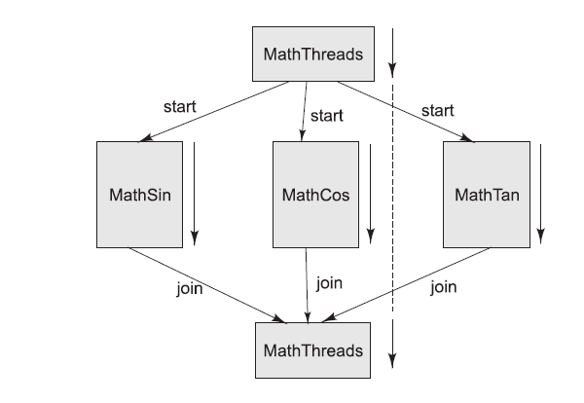
A PROGRAM WITH MULTIPLE THREADS
To illustrate creation of multiple threads in a program performing concurrent operations, let us consider the processing of the following mathematical equation: p= sin (x) + cos (y) + tan (z)

Slide 69
Concurrency in a Distributed System:
Distributed System introduces more challenges of concurrency due to
No directly shared resources (e.g., memory)
No global state
No global clock
No centralized algorithms
presence of communication delays

Slide 70
DISTRIBUTED MUTUAL EXCLUSION
Concurrent access to distributed resources
Must prevent race conditions during critical regions
Requirements:
Safety: At most one process may execute the critical section at a time
Liveness: Requests to enter and exit the critical section ultimately succeed
Ordering: Requests are processed in happened-before ordering

Slide 71
METHOD 1: CENTRAL SERVER
Simplest approach: use a central server that controls the entering and exiting of critical sections.
Requests to enter and exit a critical section are sent to a lock server (or coordinator)
Permission to enter is granted by receiving a token
When critical section left, token is returned to the server

Slide 72
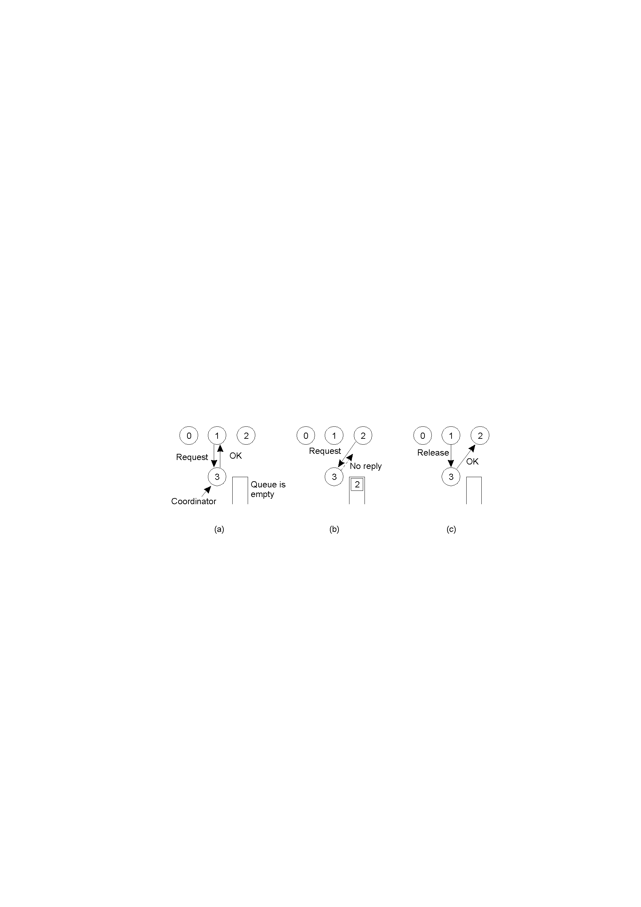
A Centralized Algorithm
Process 1 asks the coordinator for permission to enter a critical region. Permission is granted
Process 2 then asks permission to enter the same critical region. The coordinator does not reply. (Or, can say “denied”)
When process 1 exits the critical region, it tells the coordinator, when then replies to 2.

Slide 73
Cont...
This scheme is easy to implement, but it does not scale well due to the central authority.
Moreover, it is vulnerable to failure of the central server.

Slide 74
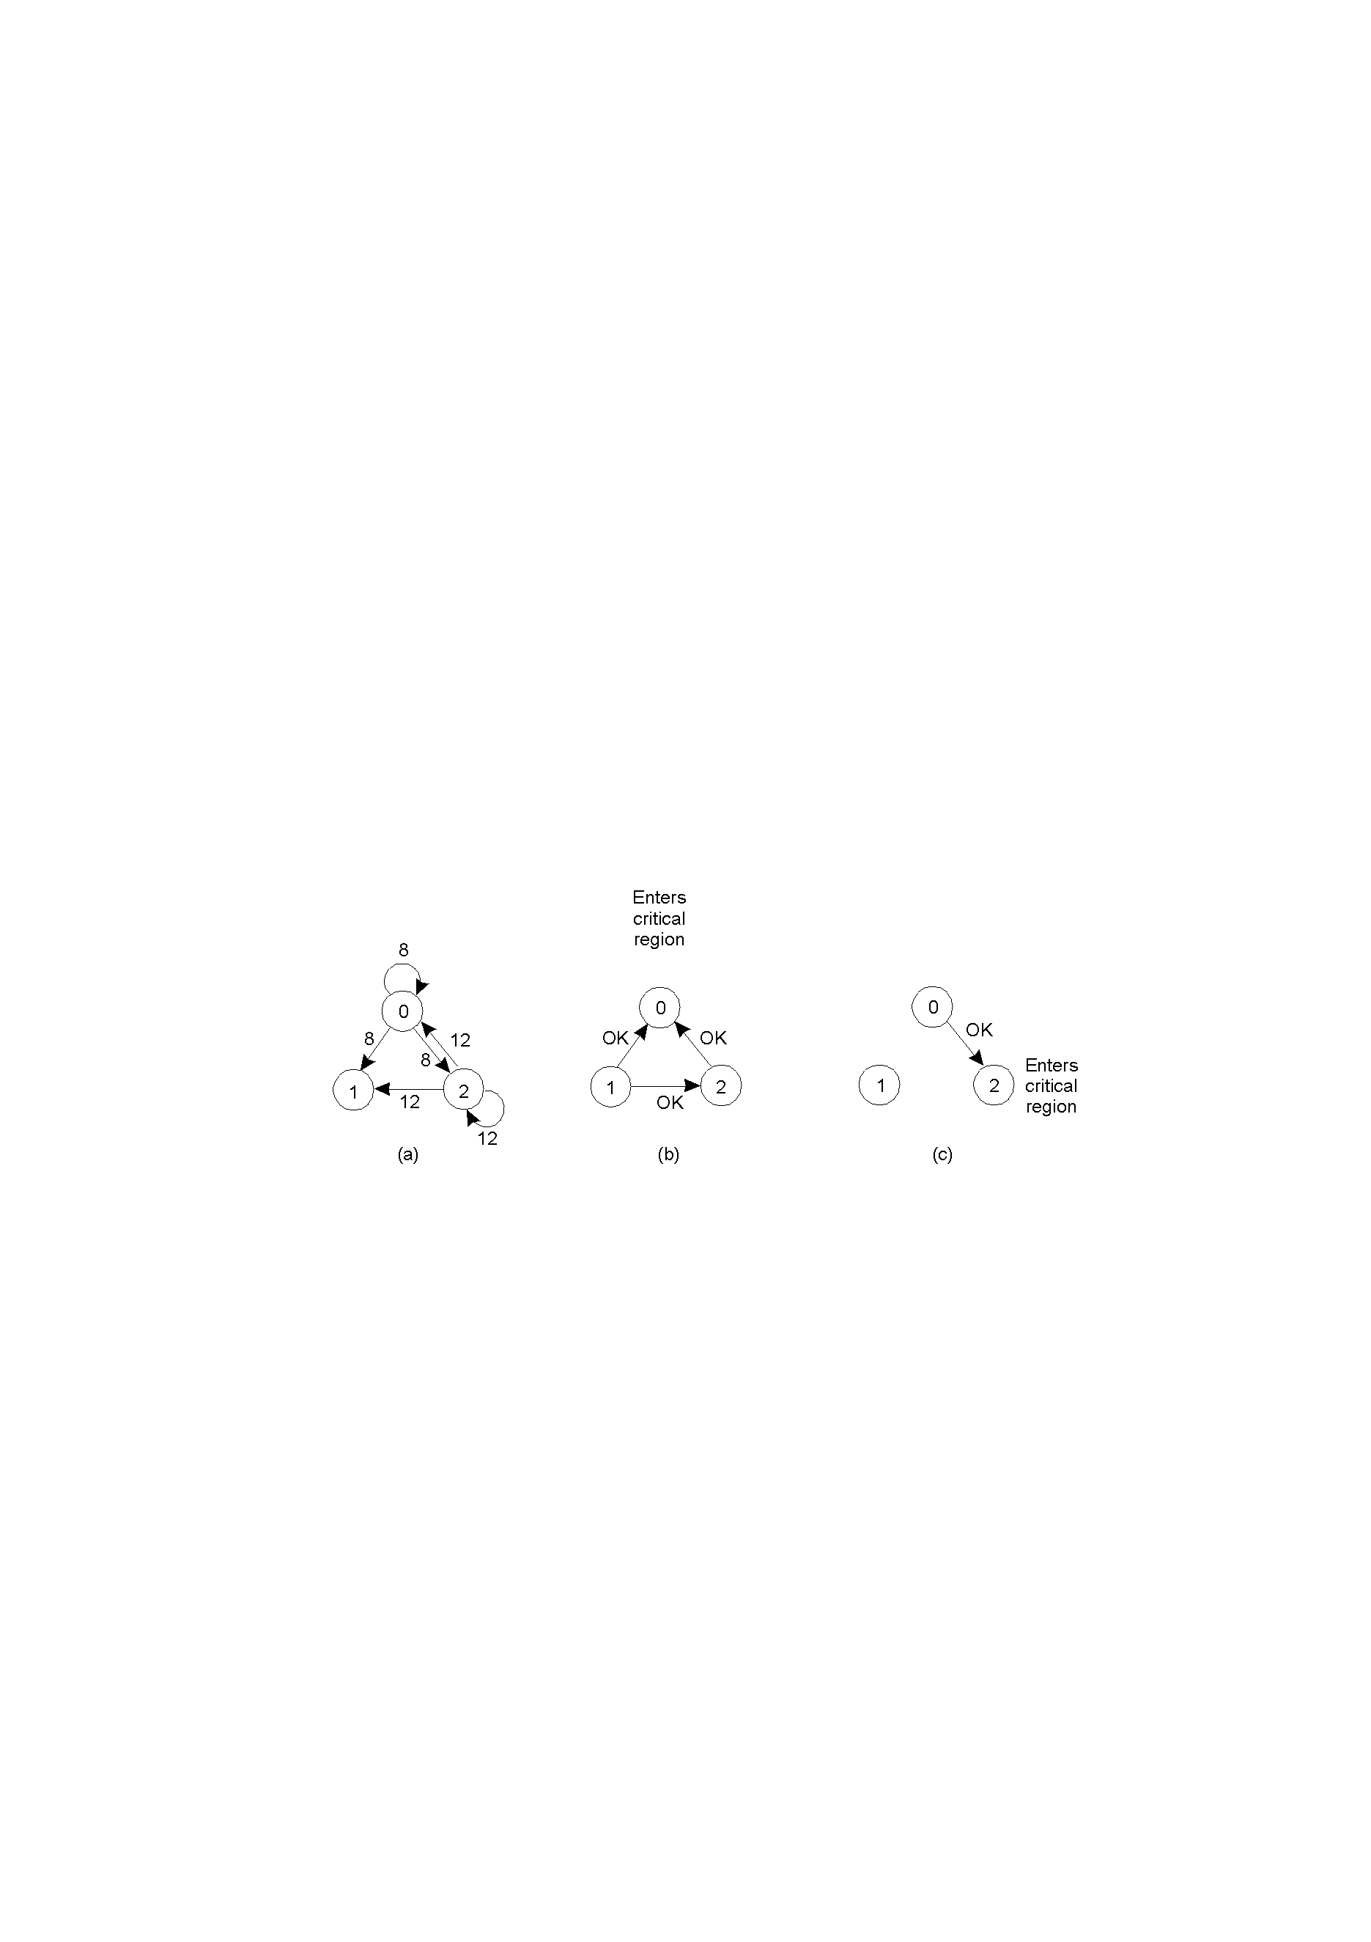
A Distributed Algorithm
Processes 0 and 2 want to enter the same critical region at the same moment.
Process 1 doesn’t want to enter into critical region, says “OK”. Process 0 has the lowest timestamp, so it wins. Queues up “OK” for 2.
When process 0 is done, it sends an OK to 2 so can now enter the critical region.

Slide 75

M ETHOD 2: TOKEN RING
Implementation:
All processes are organised in a logical ring structure
A token message is forwarded along the ring
Before entering the critical section, a process has to wait until the token comes
Must retain the token until the critical section is left

Slide 76
Properties:
Ring limits scalability
Token messages consume bandwidth
Failing nodes or channels can break the ring (token might be lost)

Slide 77
METHOD 3: USING MULTICASTS AND LOGICAL CLOCKS
Algorithm by Ricart & Agrawala: proposed an algorithm for distributed mutual execution that makes use of logical clocks.
Processes pi maintain a Lamport clock and all process must be able to communicate pairwise
At any moment, each process is in one of three states:
Released: Outside of critical section
Wanted: Waiting to enter critical section
Held: Inside critical section

Slide 78
Process behaviour:
1. If a process wants to enter a critical section, it
•multicasts a message( Li, pi) and
•waits until it has received a reply from every process
2. If a process is in Released , it immediately replies to any request to enter the critical section
3. If a process is in Held , it delays replying until it is ﬁnished with the critical section
4. If a process is in Wanted , it replies to a request immediately only if the requesting timestamp is smaller than the one in its own request

Slide 79
Properties:
Better scalability, but multicast leads to increasing overhead.
Unfortunately, failure of any peer process can deny all other process entry to the critical section.

Slide 80
MUTUAL EXCLUSION: A COMPARISON
Messages Exchanged : Messages per entry/exit of critical section
Centralised:3 (two to enter and one to leave)
Ring:1→ ∞
Multicast:2(n−1)
Delay: Delay before entering critical section
Centralised: 2
Ring: 0→n−1
Multicast:2(n−1)
Reliability:
Centralised: coordinator crashes
Ring: lost token, process crashes
Multicast: any process crashes

Slide 81
DISTRIBUTED TRANSACTIONS

Slide 82
TRANSACTIONS
Transaction:
  Comes from database world: the concept of a transaction originates from the database community as a mechanism to maintain the consistency of databases.
  Defines a sequence of operations
  Atomic in presence of multiple clients and failures
Mutual Exclusion :
  Protect shared data against simultaneous access
  Allow multiple data items to be modified in single atomic action
Transaction Model:
  Operations:
    Begin Transaction
    End Transaction
    Read
    Write
  End of Transaction:
    Commit
    Abort

Slide 83
ACID PROPERTIES
atomic: must follow an "all or nothing" rule. Each transaction is said to be atomic if when one part of the transaction fails, the entire transaction fails and database state is left unchanged.
consistent: concurrent transactions will not produce inconsistent results;
isolated: transactions do not interfere with each other i.e. no intermediate state of a transaction is visible outside , it refers to the requirement that other operations cannot access data that has been modified during a transaction that has not yet completed.
durable: after a commit, results are permanent (even if server or hardware fails)

Slide 84
CLASSIFICATION OF TRANSACTIONS
Flat: sequence of operations that satisfies ACID
Nested: hierarchy of transactions
Distributed: (flat) transaction that is executed on distributed data
Flat Transactions:
  Simple
  Failure all changes undone
BeginTransaction
accountA -= 100;
accountB += 50;
accountC += 25;
accountD += 25;
EndTransaction

Slide 85
NESTED TRANSACTION
Subdivide a complex transaction into many smaller sub-transactions
As a result, if a single sub-transaction fails, the work that went into others is not necessary wasted
Example:
  Booking a flight
    Sydney Manila
    Manila Amsterdam
    Amsterdam Toronto
What to do?
  Abort whole transaction
  Partially commit transaction and try alternative for aborted part
  Commit nonaborted parts of transaction

Slide 86
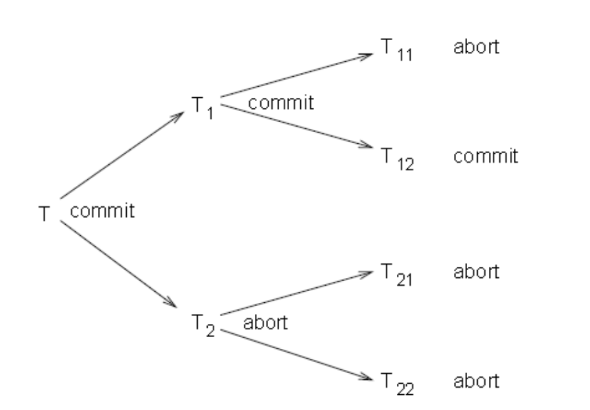
Cont…
Subtransactions and parent transactions
Parent transaction may commit even if some subtransactions aborted
Parent transaction aborts all subtransactions abort

Slide 87
Cont…
Subtransactions:
  Subtransaction can abort any time
  Subtransaction cannot commit until parent ready to commit
    Subtransaction either aborts or commits provisionally
    Provisionally committed subtransaction reports provisional commit list, containing all its provisionally committed subtransactions, to parent
    On abort, all subtransactions in that list are aborted.

Slide 88
TRANSACTION IMPLEMENTATION
Private Workspace:
  Perform all tentative operations on a shadow copy of the server state
  Atomically swap with main copy on Commit
  Discard shadow on Abort.

Slide 89
Cont…
Writeahead Log:
  In-place update with writeahead logging
  Log is reverted when a transaction Aborts

Slide 90
CONCURRENCY CONTROL
It is often necessary to allow transactions to occur simultaneously (for example, to allow multiple travel agents to simultaneously reserve seats on the same flight).
Due to the consistency and isolation properties of transactions, concurrent transaction must not be allowed to interfere with each other.
Concurrency control algorithms for transactions guarantee that multiple transactions can be executed simultaneously while providing a result that is the same as if they were executed one after another.

Slide 91
CONCURRENCY CONTROL
Simultaneous Transactions:
  Clients accessing bank accounts
  Travel agents booking flights
Problems:
  Simultaneous transactions may interfere
    Lost update
    Inconsistent retrieval
  Consistency and Isolation require that there is no interference
Concurrency Control Algorithms:
  Guarantee that multiple transactions can be executed simultaneously while still being isolated.
  As though transactions executed one after another

Slide 92
CONFLICTS AND SERIALISABILITY
conflict: operations (from the same, or different transactions) that operate on same data
read-write conflict: one of the operations is a write
write-write conflict: more than one operation is a write
Define a Schedule of operations:
  Total ordering (interleaving) of operations
  Legal schedules provide results as though the transactions were serialised (i.e., performed one after another) (serial equivalence)

Slide 93
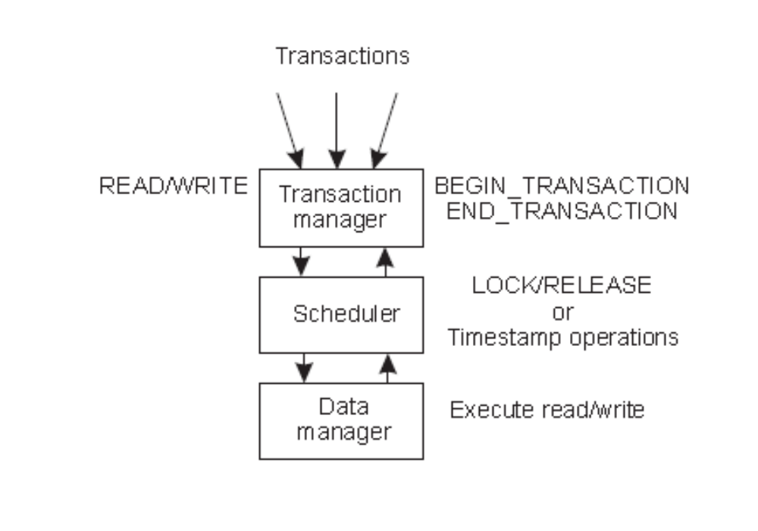
MANAGING CONCURRENCY
Transaction Managers:

Slide 94
Dealing with Concurrency:
Locking
Timestamp Ordering
Optimistic Control

Slide 95
LOCKING
Pessimistic approach: prevent illegal schedules
  The locking algorithms require that each transaction obtains a lock from a scheduler process before performing a read or a write operation.
  The scheduler is responsible for granting and releasing locks in such a way that legal schedules are produced.
  Ensures that only valid schedules result

Slide 96
TWO PHASE LOCKING (2PL)
The most widely used locking approach is two-phase locking (2PL).
In this approach a lock for a data item is granted to a process if no conflicting locks are held by other processes (otherwise the process requesting the lock blocks until the lock is available again).
Lock is not released until operation executed by data manager
No more locks granted after a release has taken place
All schedules formed using 2PL are serialisable.

Slide 97
PROBLEMS WITH LOCKING
Deadlock
Cascaded Aborts: If a transaction (T1) reads the results of a write of another transaction (T2) that is subsequently aborted, then the first transaction (T1) will also have to be aborted.

Slide 98
TIMESTAMP ORDERING
Each transaction has unique timestamp (ts(Ti))
Each operation (TS(W), TS(R)) receives its transaction’s timestamp
Each data item has two timestamps:
• read timestamp: tsRD(x) - the timestamp of the last read x
• write timestamp: tsWR(x) - the timestamp of the last committed write x
Timestamp ordering rule:
• write request only valid if TS(W) > tsWR and TS(W) ≥ tsRD
• read request only valid if TS(R) > tsWR
Conflict resolution:
• Operation with lower timestamp executed first

Slide 99
OPTIMISTIC CONTROL
Assume that no conflicts will occur.
  Detect & resolve conflicts at commit time
  A transaction is split into three phases:
    Working (using shadow copies)
    Validation
    Update
  In the working phase operations are carried out on shadow copies with no attempt to detect or order conflicting operations.

Slide 100
Cont….
In the validation phase the scheduler attempts to detect conflicts with other transactions that were in progress during the working phase.
If conflicts are detected then one of the conflicting transactions are aborted.

Slide 101
Cont…
In the update phase, assuming that the transaction was not aborted, all the updates made on the shadow copy are made permanent.

Slide 102
DISTRIBUTED TRANSACTIONS
In distributed system, a single transaction will, in general, involve several servers:
  transaction may require several services,
  transaction involves files stored on different servers
All servers must agree to Commit or Abort, and do this atomically.

Slide 103
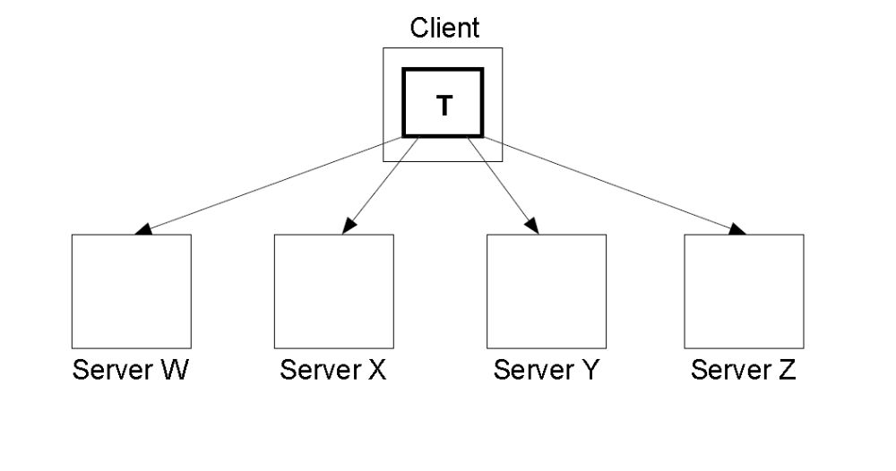
Distributed Flat Transaction:

Slide 104
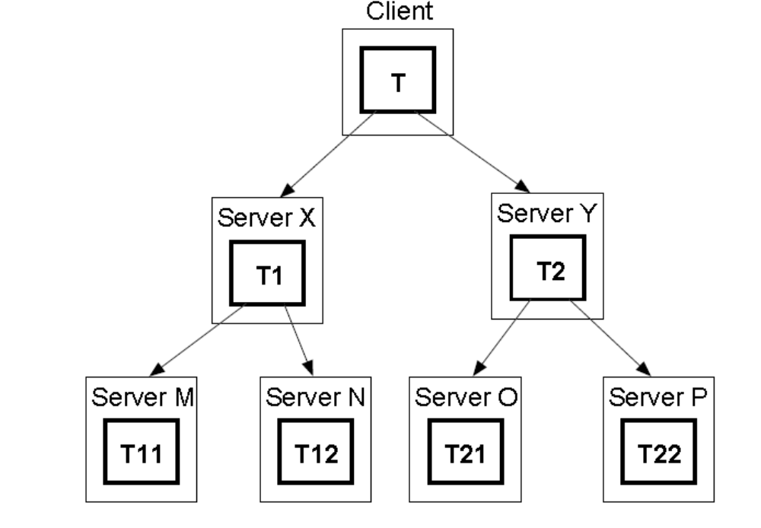
Distributed Nested Transaction:

Slide 105
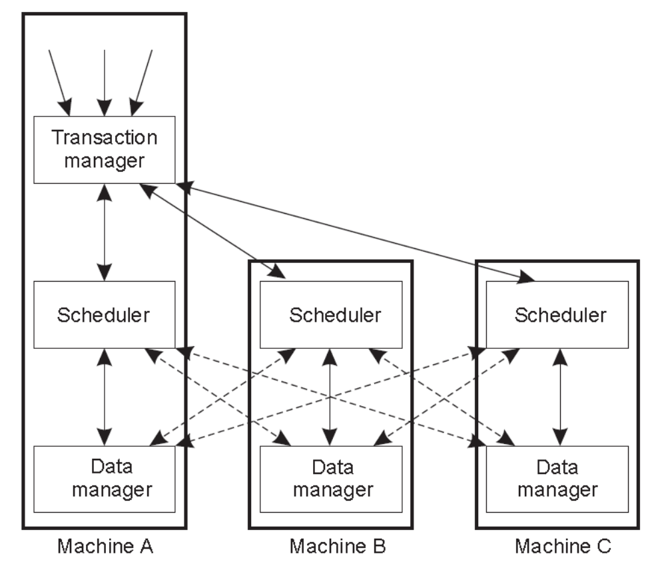
DISTRIBUTED CONCURRENCY CONTROL

Slide 106
DISTRIBUTED LOCKING
Distributed 2PL:
  Data can be replicated
  Scheduler on each machine responsible for locking own data
  Read lock: contact any replica
  Write lock: contact all replicas

Slide 107
ATOMICITY AND DISTRIBUTED TRANSACTIONS
Distributed Transaction Organisation:
  Each distributed transaction has a coordinator, the server handling the initial BeginTransaction call
  Coordinator maintains a list of workers, i.e. other servers involved in the transaction
  Each worker needs to know coordinator
  Coordinator is responsible for ensuring that whole transaction is atomically committed or aborted
    Require a distributed commit protocol.

Slide 108
DISTRIBUTED ATOMIC COMMIT
Transaction may only be able to commit when all workers are ready to commit (e.g. validation in optimistic concurrency)
Distributed commit requires at least two phases:
  Voting phase: all workers vote on commit, coordinator then decides whether to commit or abort.
  Completion phase: all workers commit or abort according to decision.
Basic protocol is called two-phase commit (2PC)

Slide 109
Two-phase commit: Coordinator
Sends CanCommit, receives yes, abort;
Sends DoCommit, DoAbort
If yes messages are received from all workers, the coordinator sends a DoCommit message to all workers, which then implement the Commit. However, if any of the workers replies with abort instead of yes, the coordinator sends a DoAbort message to all workers to trigger a collective Abort.

Slide 110
Two-phase commit: Worker
Receives CanCommit, sends yes, abort;
Receives DoCommit, DoAbort
A worker on receiving a CanCommit message answers with either a yes or abort message, depending on the workers internal state. Afterward, it commits or aborts depending on the instructions from the coordinator.
The only extra case is where the worker is in an abort cycle and immediately answers a CanCommit with an abort.

Slide 111
Failures can be due to:
  server failures/hosts:
    If a host fails in the 2PC protocol, then, after being restarted, it aborts all transactions.
    restarting worker aborts all transactions
  Failure of communication channels/network:
    coordinator aborts after timeout.

Slide 112
Two-phase commit with timeouts: Worker
On timeout sends GetDecision
Whenever a worker that is ready to commit when receiving a CanCommit message times out while waiting for the decision from the coordinator, it sends a special GetDecision message that triggers the coordinator to resend the decision on whether to Commit or Abort.
These messages are handled by the coordinator once the decision between committing and aborting has been made. Moreover, the coordinator resends CanCommit messages if a worker does not issue a timely reply.

Slide 113
Two-phase commit with timeouts: Coordinator
On timeout re-sends CanCommit, On GetDecision repeats decision

Slide 114
Limitations(2PC)
Once node voted “yes”, cannot change its mind, even if crashes.
  Atomic state update to ensure “yes” vote is stable.
If coordinator crashes, all workers may be blocked.
  Can use different protocols (e.g. three-phase commit),
  in some circumstances workers can obtain result from other workers.

Slide 115
SUMMARY
Distributed Algorithms:
Timing models
Time:
Clock synchronisation
Logical clocks
Vector clocks
Concurrency Control:
Distributed mutual exclusion
Distributed transactions
2PC

